Slide 1




Precision Loan Eligibility System

Slide 2





1
Bandi, Mallikarjuna Reddy
TEAM MEMBERS
2
Yarlagadda, Nikitha
3
Labba, Yeswanth

Slide 3


1
Project Overview
2
Objective
3
Significance
Agenda
4
Business Understanding
Topics Covered
5
Data Overview
6
Outlier Detection and Handling:
7
Modelling Pipeline

Slide 4

Project Overview:
It aims to enhance financial institutions' loan decision processes by building an accurate and explainable loan eligibility model.
Objective:
Develop a model that reliably predicts loan eligibility by addressing data quality, enhancing interpretability, and reducing potential biases in predictions.
Significance:
Accurate predictions minimize risk, optimize approval rates, and ensure compliance with financial regulations.

Slide 5


Business Understanding
Industry: Finance, specifically loan approvals and risk assessment
Challenge: Traditional loan models are often inaccurate due to poor data quality, missing values, and simplistic decision rules. These issues can lead to false approvals or rejections, impacting both lenders and applicants.
Impact: Predictify addresses these challenges by improving prediction accuracy, which in turn can reduce defaults and boost customer satisfaction.
Value Proposition: Predictify offers a precise, data-driven approach that benefits both applicants and lenders by enabling fairer and more reliable loan decisions.

Slide 6
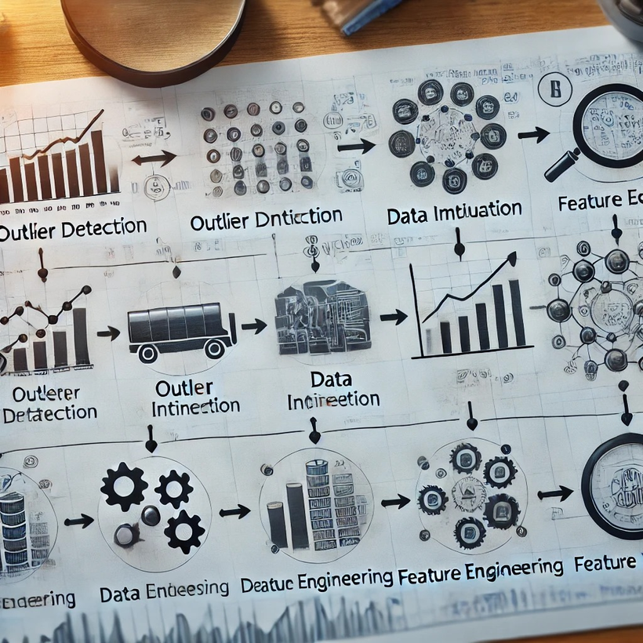

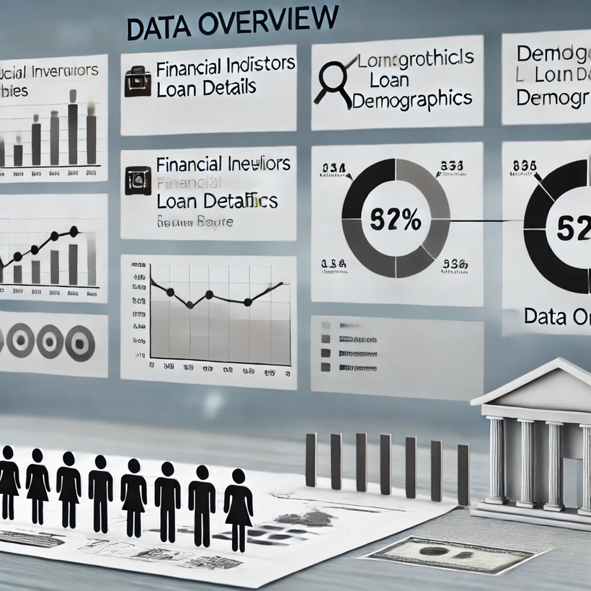

Slide 7
Data Overview
Data Sources:
Internal Data: Loan applicant details, credit scores, employment history
External Data: Financial indicators like interest rates, economic stability metrics
Socio-Economic Data: Population demographics, regional employment rates
Key Attributes:
Applicant-Level Data: Income, debt-to-income ratio, credit score, employment history
Financial Indicators: Loan amount requested, term length, interest rate
Challenges:
Missing values in key attributes (e.g., income or credit score), data inconsistencies, and extreme values necessitate robust preprocessing techniques to prepare reliable datasets.

Slide 8
Outlier Detection and Handling:
Detect and manage outliers with Interquartile Range (IQR) and DBSCAN. This helps prevent extreme values from skewing model predictions.
Advanced Imputation Techniques:
Use K-Nearest Neighbors (KNN) imputation for numeric values, and mode imputation for categorical fields like employment status, ensuring more accurate data completion.
Feature Engineering:
Add derived features, such as debt-to-income ratio and employment stability score, to improve model performance.
Automated Pipeline:
Create a data processing pipeline that consistently performs outlier removal, imputation, and feature engineering for all data sources.

Slide 9
Modelling Pipeline :
Now lets go through the workflow, showing the sequential stages and tools used for data processing, model building, and deployment.
1. Data Source
- Kaggle and CSV files: The data originates from external sources like Kaggle datasets or locally stored CSV files.
2. Data Storage
- GitHub: Acts as the repository to store, version, and manage the code and data, providing a centralized storage.
3. Extract & Load
-Jupyter Notebook and VS Code: These tools are used for loading and managing the data. They serve as Integrated Development Environments (IDEs) where the code for data extraction, loading, and processing is written and executed.
4. Data Preprocessing
-Python with libraries like NumPy and Pandas: This stage involves cleaning, transforming, and preparing the data for analysis.

Slide 10
5. Data Visualization
- Matplotlib, Plotly: These libraries create visualizations to understand data patterns, trends.
6. Model Building
- Scikit-Learn: This machine learning library provides algorithms for model training, testing, and evaluation. Scikit-Learn is used to build predictive models based on the preprocessed data.
7. Process Streamline
- Apache Airflow: This workflow management tool automates the entire pipeline, ensuring that each step is executed in sequence.
8. Deployment
- AWS (Amazon Web Services): Once the model is trained, it’s deployed on AWS for scalability and accessibility. This deployment allows the model to be used in real-time applications.

Slide 11


Any Queries???
Thank you!

